Slide 1


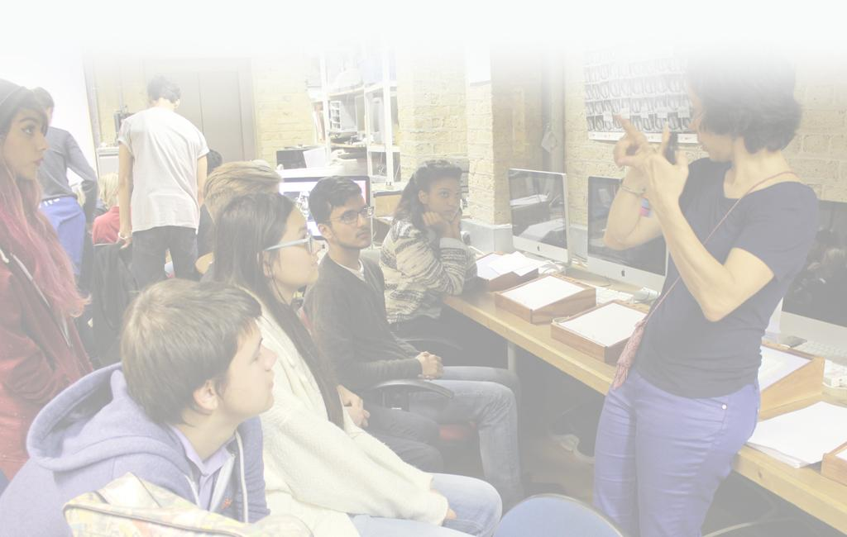
BFI - Film Academy
  20 years experience delivering educational projects to young people
  Delivered £3.8 Million worth of projects
  Successful completion of 5 network and 4 residential Film academy projects

Slide 2
Overview
A free short course to develop your skills and employability.
  Build your professional online portfolio.
  In a small group, make your own film.
  The tutors all work in the industry.
  Understand the world of Film & TV.
  Get industry training in specialist apps such as; Premiere, After Effects & Final Cut Pro.
  Learn from high profile visiting speakers who will be sharing tips, trade secrets and how they got their jobs.
  £25 deposit (refunded after completion)

Slide 3




Partner
Blink and Blinkink
  World leaders in making adverts
  Work with international brand names
  Helped develop the programme, and will provide visiting speaker and professional guidance to students

Slide 4
When & Where
  Deadline for applications - Friday 22nd Jan 2027, 17:00
  Online intro session – Thurs eve 4/2/27
  Academy - Monday to Friday during the Autumn half term (Monday 15/2/27 to Friday 19/2/27).
  Next steps day - Sat 27/2/27
  Screening - at NFT1 @ BFI Southbank
  Times - 10:00 to 17:00
  Where – Croydon venue TBC

Slide 5
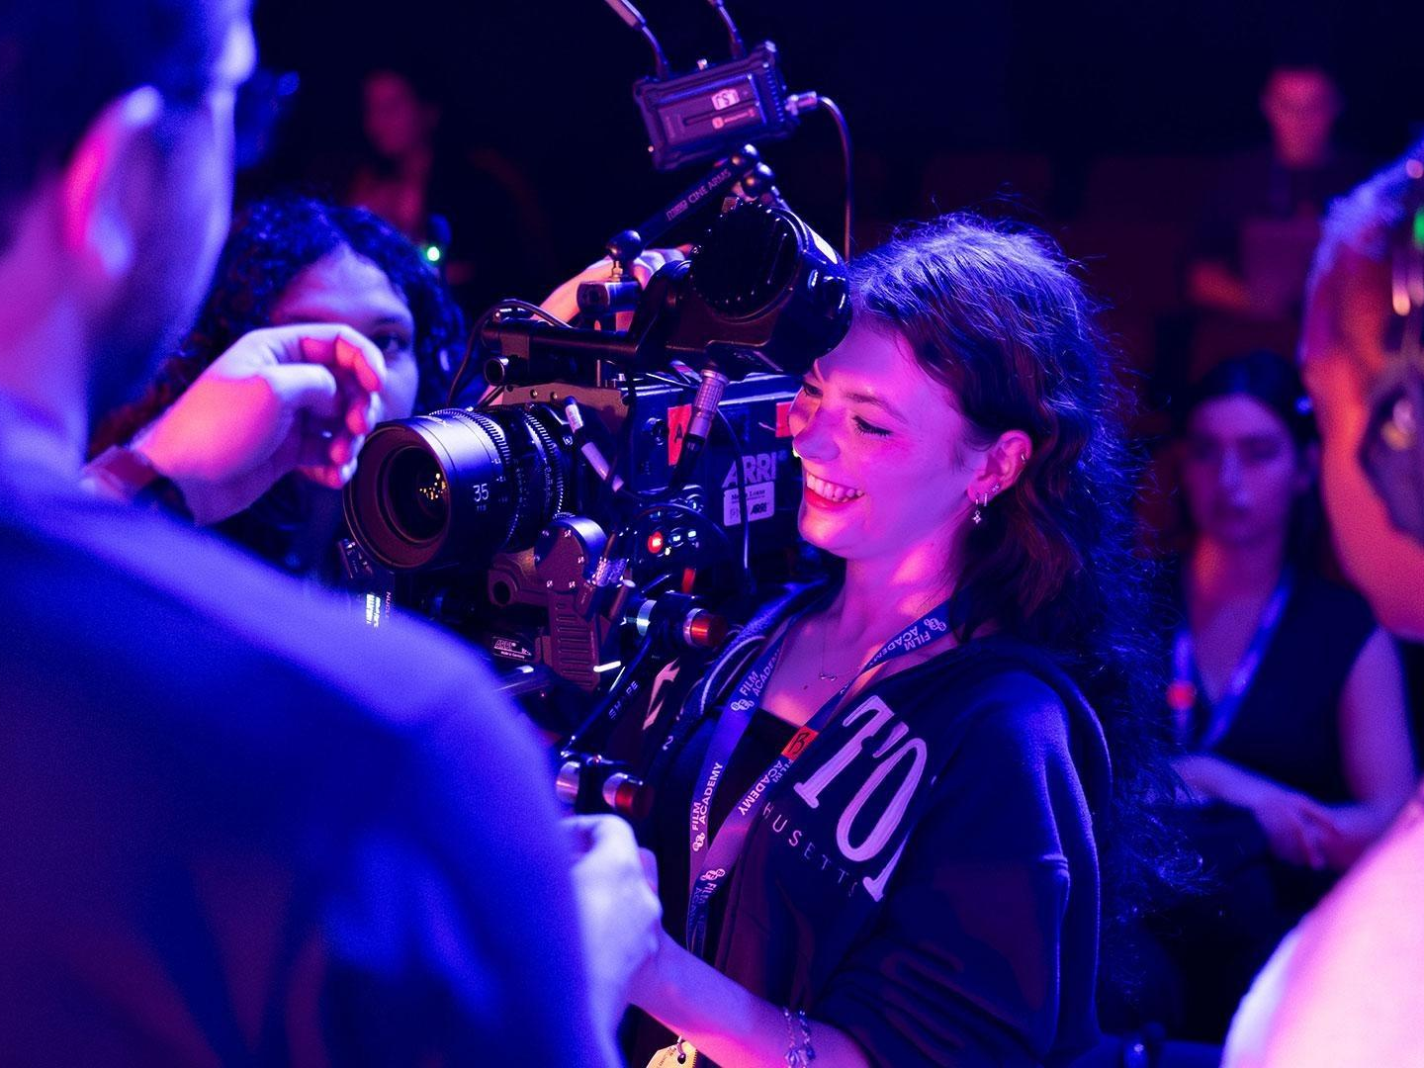
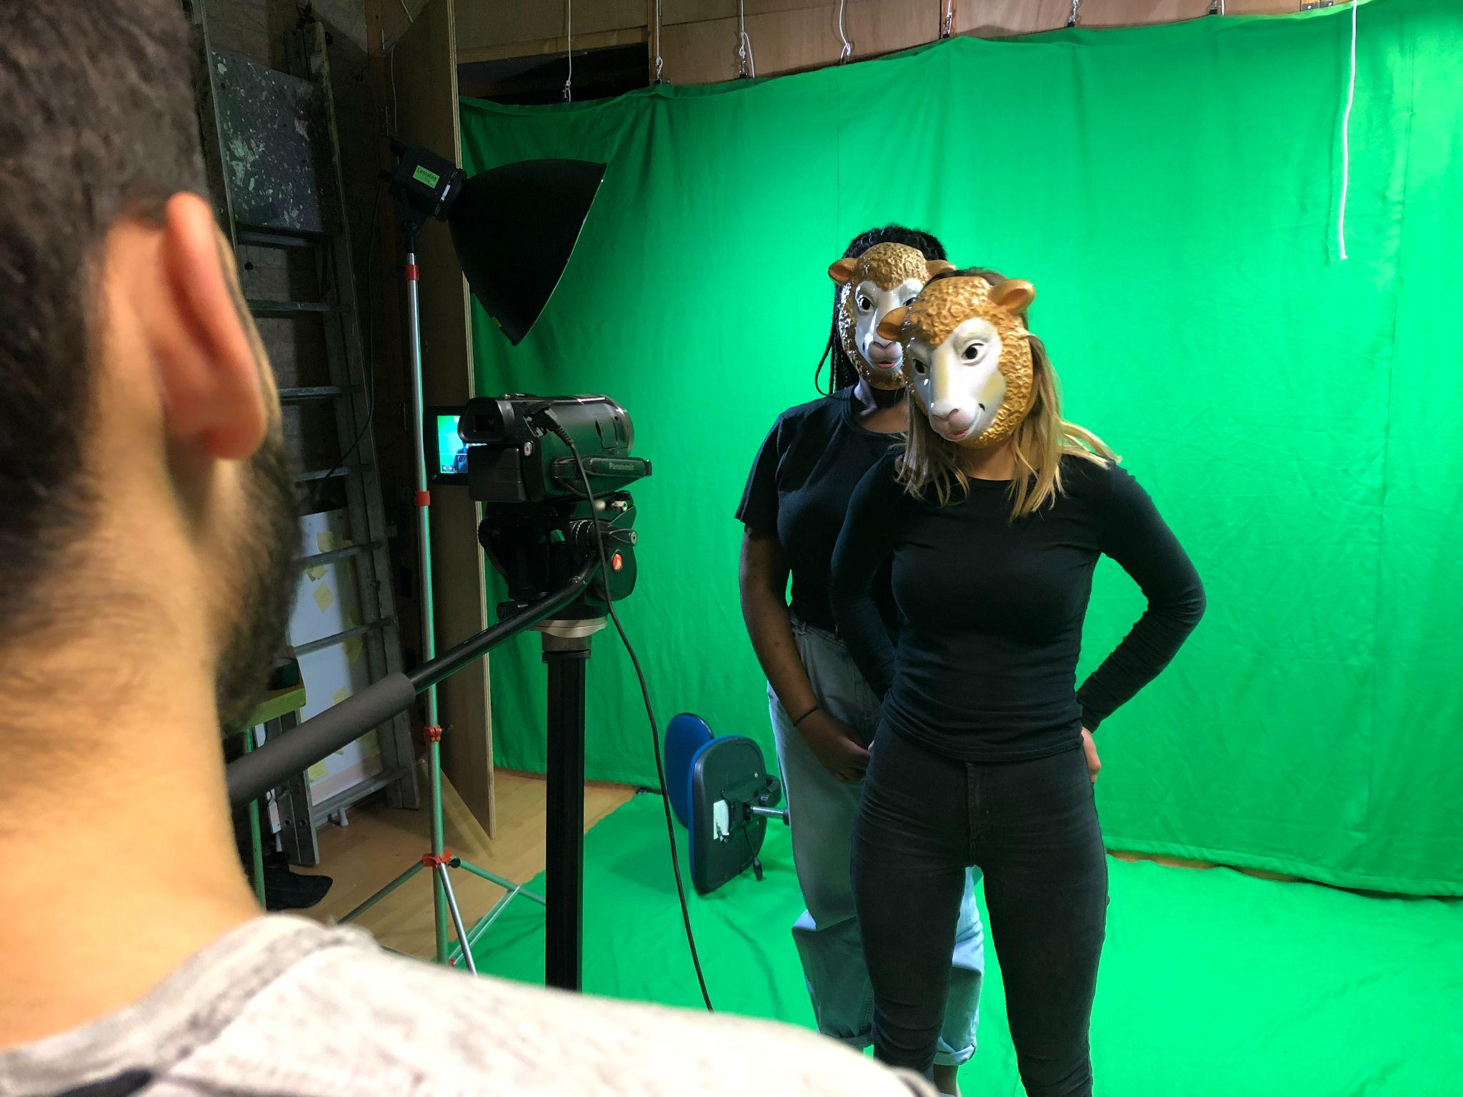
Apply and more info
Go to
https://www.filmworkshop.com/film-academy/
For help
booking@filmworkshop.com or call 0207 607 8660

Slide 6


BFI Film Academy
London

